Slide 1

Four As of Autism: a societal response
Dr. Lirio S. Covey, Ph.D.
President, Association for Adults with Autism Philippines
Presented at the National Autism Consciousness Week 2018
Bayanihan Annex, Pasig City, Philippines

Slide 2
Society’s Responses
AWARENESS
ACCEPTANCE
ADAPTATION
ACCOMODATION

Slide 3
What they are, what they are not.
AWARENESS vs. Denial
ACCEPTANCE vs. Rejection
ADAPTATION vs. Adherence to convention
ACCOMODATION vs. Neglect

Slide 4
When actualizing the 4 As -
What to consider?
Definitions in practice.
Who will execute?
When?

Slide 5
If you’ve seen one person with autism, you’ve seen one person with autism.
.

Slide 6
If you’ve seen one autism family, you’ve seen one autism family.

Slide 7
1. AWARENESS: Autism Spectrum Disorder Characteristics in DSM-V
Core symptoms –
  impairments in social interaction and communication
  restricted, repetitive, and stereotyped patterns of behavior.
Typically apparent by age 3, but can become apparent only at older age. Some recognized only in adulthood.
Features:
Usually life-long, rare cases of reported “cure”.
Cause(s): Primarily genetic – inherited or random mutation
Observable in persons’ behaviors, no biologic markers

Slide 8
Who must be aware when and if autism is present?
The person’s family
The medical doctor
The school

Slide 9
2. ACCEPTANCE
Respect and love vs
  denial and rejection
Equal educational or training activities as non-autistics vs
    withdrawal of opportunities

Slide 10
From whom will acceptance come ?
Primarily - the person’s family
Mother, father, siblings, relatives
As a result – the larger social environment
The medical doctor who will provide the same level of treatment and care
The school to the extent that it has the facilities

Slide 11
3. Adaptation
Based on Awareness of the autistic person’s strengths and limitations
Modifying the environment to create environmental conditions compatible with the autistic person’s abilities or impairments (not conventional society).
  In essential life areas of diet, physical activity, sleep, recreation

Slide 12
Who will carry out these adaptations?
Family – adjust living (residential, play, work) arrangements
to engage in enriching conditions
and avoid or minimize harmful ones
Schools – develop targeted asset improvement training; in lessons, reading materials, physical equipment

Slide 13
4. Accomodation
A place to work , play, and stay.
Safe – physical, emotional, medical
Comfortable – physical, emotional
Independence – psychological and financial to the extent possible
Growth – continued development of skills and talents
Social interaction – friendships, company, relationships

Slide 14
GOVERNMENT must be a Major Partner
AWARENESS – PUBLIC EDUCATION
ACCEPTANCE – PROTECTIVE LAWS
ADAPTATION – PUBLIC SCHOOLS DELIVER SPECIAL EDUCATION AND TRAINING PROGRAMS, HEALTH CARE AND DRUG BENEFITS, SPECIAL PAY RATES
ACCOMODATION - GOV’T SUPPORTED ASSISTED HOUSING FOR AUTISTIC ADULTS

Slide 15
The 4 As in Societal Response to Autism
The critical time points
Accomodation
Adaptation
Acceptance
Awareness
Childhood Adolescence Young adulthood Adulthood to Later age

Slide 16
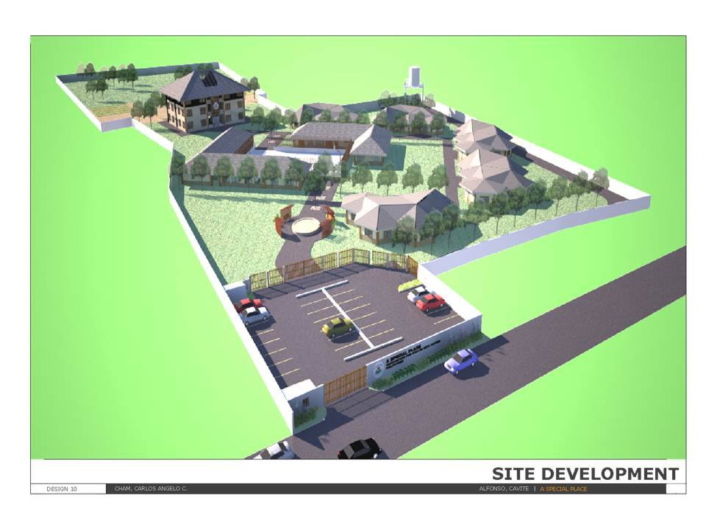
A Special Place Envisioned

Slide 17
AAAP
Association for Adults with Autism Philippines
www.adultautismphil@gmail.com or AAAP Today
http://adultautismphil.wordpress.com
Facebook: Association for Adults with Autism Philippines
Growing Up with Autism: Journeys of Hope, Devotion, and Love. An anthology of narratives written by AAAP parents, edited by Lirio Covey. Available in hard copy at Vico’s Artism Gallery (Pasig) and ebook in Amazon.com and Barnes and Nobles.com

