Slide 1


Epilepsy in Autism Spectrum Disorder
Aida M. Salonga, MD
Director and Professor
Institute of Child Health and Human Development
National Institutes of Health
University of the Philippines Manila

Slide 2
Objectives
To present the prevalence of Epilepsy in ASD
To be able to define epilepsy and seizures
To be able to recognize the different seizure types
To be able to understand the basic principles of epilepsy diagnosis and treatment, specifically in ASD

Slide 3
Epilepsy and Autism
Prevalence of epilepsy among all children is 2-3%
5-38% among children with autism
  Risk for epilepsy increased with greater intellectual disability, symptomatic vs. idiopathic, age and history of regression
  35-65% with EEG abnormalities
Epilepsy in autism is associated with increased mortality
Notes:
6-35% epilepsy; 6-60% with EEG abnormalities

Slide 4
Autistic Disorder – More than 1/3 of epilepsy observed by adolescence
Asperger’s syndrome - Estimated 5-10% likelihood of developing epilepsy in early childhood
Pervasive Developmental Disorder - Risk for epilepsy linked to underlying brain dysfunction
Disintegrative Disorder - Risk for epilepsy as high as 70%
Rett’s Syndrome - Risk for epilepsy is more than 90%

Slide 5
Diagnosis is complicated because seizures may be mistaken for autism behaviors (not responding to name calling, as in Absence)
Unusual repetitive behaviors, common in autism, hard to distinguish from seizures
All seizure types may be seen in one person

Slide 6
WHAT IS EPILEPSY?

Slide 7
EPILEPSY
Epilepsy (sometimes referred to as a seizure disorder) is a common chronic neurological condition that is characterized by recurrent unprovoked epileptic seizures.
It is usually controlled, but not cured.
It affects approximately 50 million people worldwide.
80% of those live in the developing world
In the Philippines, estimated 930,000 people suffer from epilepsy.
In a local prevalence study: 230 persons with epilepsy / 100,000 population.
WHO and PLAE data

Slide 8
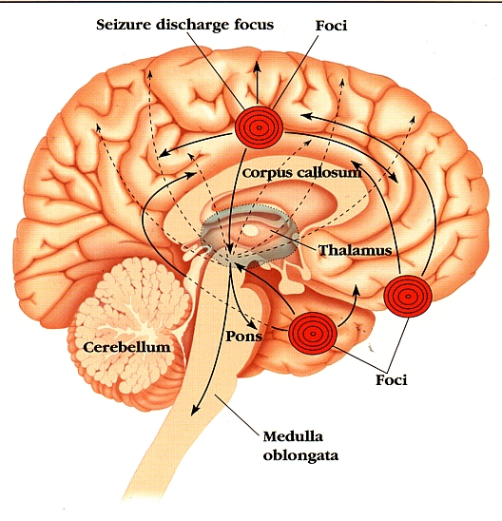
Seizure
An occasional excessive and disordered discharge of neurons
Manifestation of transient hypersynchronous abnormal neuronal behavior

Slide 9
Definition of Terms
EPILEPTIC SEIZURE
  Manifestation(s) of epileptic (excessive and/or hypersynchronous), usually self-limited activity of neurons in the brain.
EPILEPSY
  A chronic neurological condition characterized by recurrent epileptic seizures.
CONVULSION
Primarily a lay term. Episodes of excessive, abnormal muscle contractions, usually bilateral, which may be sustained or interrupted.

Slide 10
CLASSIFICATION OF EPILEPTIC SEIZURES
FOCAL (syn. partial)
initial activation of only part of one cerebral hemisphere.
GENERALIZED
more than minimal involvement of both cerebral hemispheres.
UNCLASSIFIED: SYNDROMES

Slide 11
Etiology of epilepsy
Epilepsy can be divided into three categories relating to its cause:
  Idiopathic – no identifiable cause. Seizures assumed to have a probable genetic basis
  Cryptogenic – no cause is found. There may be an undiscovered physical cause which has yet to be found
  Symptomatic – a cause for the condition can be found. Could include head injury, scarring due to infections in the brain, stroke, brain tumours
Notes:
These account for 65.5% of the aetiology of epilepsy. Majority of the cases of epilepsy have no identifiable cause and are therefore described as idiopathic.
Other aetiology:
-degenerative brain disorder
- infection
-neoplasm (tumour)
- vascular injury
- trauma
congenital causes

Slide 12
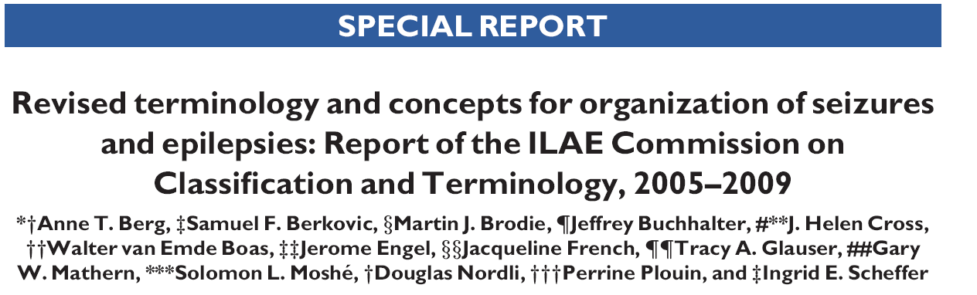
2005-2009 Commission Report,
Epilepsia 2010;51:676-685
Notes:
So new concepts and terminology for organizing the epilepsies have been recommended. This is an ORGANIZATION rather than a Classification as we are not realistically at the point at which we can classify according to the biology of these disorders in a scientific way.
In this presentation we will discuss what we have done in the new organization.
12

Slide 13
Recommended terminology for etiology
Genetic - the epilepsy is the direct result of a known or inferred genetic defect(s). Seizures are the core symptom of the disorder.
Structural-Metabolic - There is a distinct other structural or metabolic condition or disease present.
Unknown - The nature of the underlying cause is as yet unknown.
Notes:
13

Slide 14
UNDERSTANDING SEIZURE TYPES
Essential in making the diagnosis, if true seizures, and in determining possible cause
An important consideration in the selection of appropriate or ideal anti-epileptic drug

Slide 15
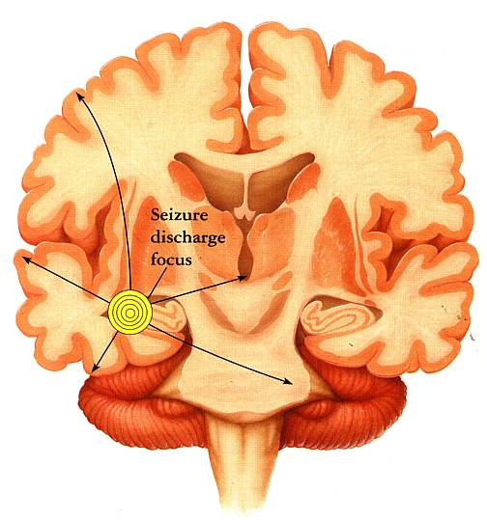
FOCAL SEIZURE (Partial seizure)
Abnormal flow of
electrical
discharge
from a specific or
single focus

Slide 16
Focal reconceptualized
  Focal epileptic seizures are conceptualized as originating within networks limited to one hemisphere. These may be discretely localized or more widely distributed.…
Notes:
16

Slide 17
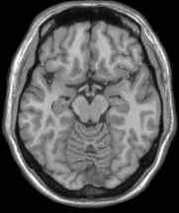
Notes:
17

Slide 18

1981 International League Against Epilepsy (ILAE) classification of Seizure Type
I. Partial seizure
A. Simple partial seizure
(consciousness not impaired)
B. Complex partial seizure
(with impairment of consciousness)
C. Partial secondarily generalized

Slide 19
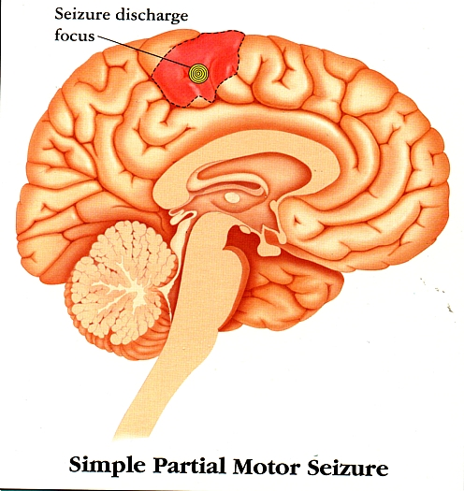
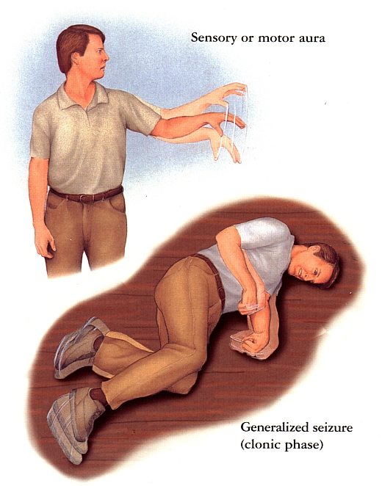
FOCAL SEIZURE without impairment of consciousness

Slide 20
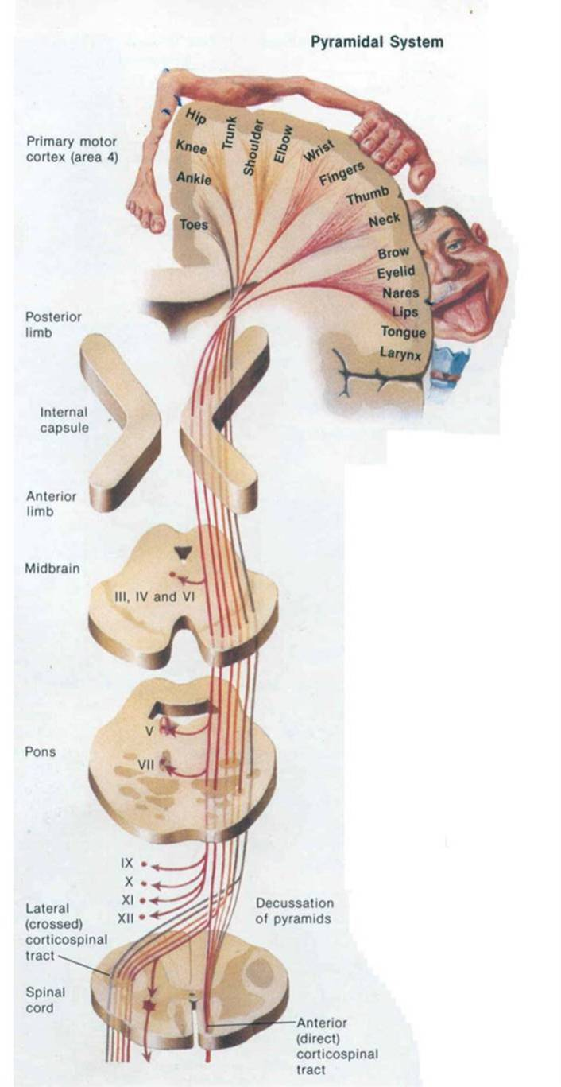
FOCAL SEIZURE with motor symptoms
Focal motor without march
Focal motor with march (Jacksonian)
Versive
Postural
Phonatory (vocalization or arrest of speech)

Slide 21
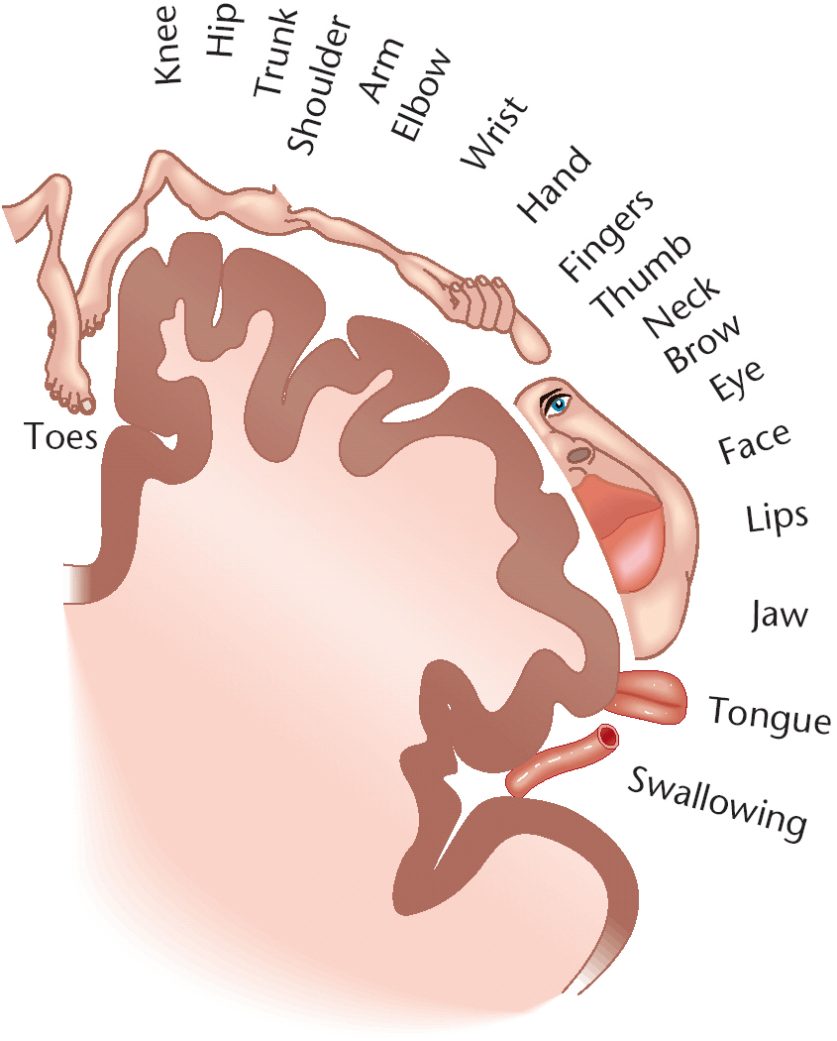
FOCAL SEIZURE with sensory symptoms
With somatosensory or special sensory symptoms
  Somatosensory
  Visual
  Auditory
  Olfactory
  Gustatory
  Vertiginous

Slide 22
Focal seizures
Blume et al, Epilepsia 2001
Without impairment of consciousness or awareness
  Previous term: simple partial
  With observable motor or autonomic components
    eg. focal clonic, autonomic, hemiconvulsive
  With subjective sensory or psychic phenomena
    Aura - specific types
Where alteration of cognition is major feature
  Previous term: complex partial
  Dyscognitive
Notes:
22

Slide 23
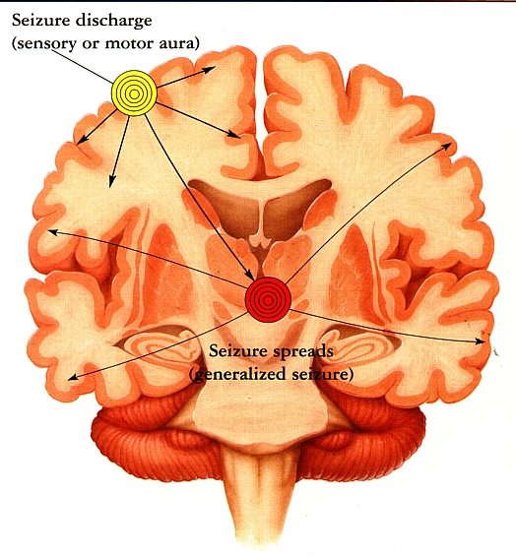
FOCAL SEIZURE EVOLVING TO BILATERAL CONVULSIVE SEIZURE
Starts off as simple seizure which later evolves into generalized seizure

Slide 24
Focal seizures
Blume et al, Epilepsia 2001
Evolving to bilateral, convulsive seizure
  Previous terms: partial seizure secondarily generalized;
  secondarily generalized tonic-clonic seizure
  With tonic, clonic or tonic and clonic components
Notes:
24

Slide 25
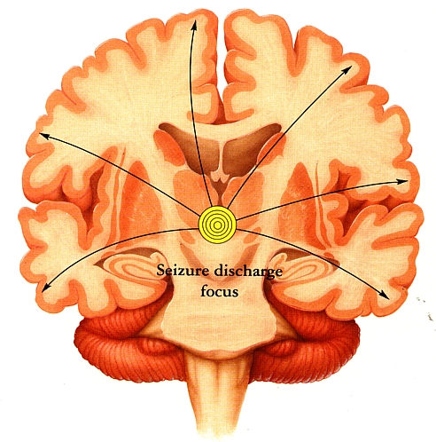
Generalized Seizures
Begin throughout both hemispheres, more or less simultaneously
Do not have localized onset
Reflect generalized disturbance of cortical function

Slide 26
Generalized - reconceptualized
  Generalized epileptic seizures are conceptualized as originating at some point within, and rapidly engaging, bilaterally distributed networks. …can include cortical and subcortical structures, but not necessarily include the entire cortex.
Notes:
It is now well understood that “generalized” seizures do not involve the whole brain, but rather networks in the brain. We have reconceptualized the term generalized in recognition of this and it is defined as above. Thus generalized seizures are now “allowed” to arise from focal lesions as the definition acknowledges this is often the case in epileptic spasms, atonic and tonic seizures.
26

Slide 27
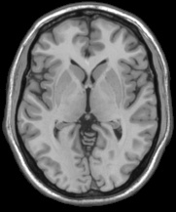
Notes:
Here is a diagram that shows a conceptual network for generalized seizures involving the corticothalamic circuitry. Theoretically a generalized seizure could start at different points in the network and engage bilaterally distributed networks. Thus a seizure could start frontally or even parietally.The key point is that a generalized seizure can start from a focal point.
27

Slide 28
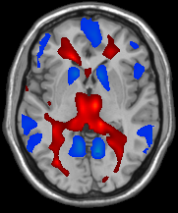
Notes:
Here is a diagram that shows a conceptual network for generalized seizures involving the corticothalamic circuitry. Theoretically a generalized seizure could start at different points in the network and engage bilaterally distributed networks. Thus a seizure could start frontally or even parietally.
Here the conceptual diagram of the network is superimposed on a functional MRI of generalized spike wave activity.
28

Slide 29
1981 International League Against Epilepsy (ILAE) classification of Seizure Type
Generalized seizures (bilaterally symmetrical and without local onset)
A. Absence seizures
B. Myoclonic seizures
C. Clonic seizures
D. Tonic seizures
E. Tonic-clonic seizures
F. Atonic seizures (astatic)

Slide 30
Generalized Seizures
Tonic-clonic (in any combination)
Absence
- Typical
- Atypical
- Absence with special features
Myoclonic absence
Eyelid myoclonia
Myoclonic
- Myoclonic
- Myoclonic atonic
- Myoclonic tonic
Clonic
Tonic
Atonic
Notes:
The organization of generalized seizures has actually been simplified from 1981 and 2006
30

Slide 31
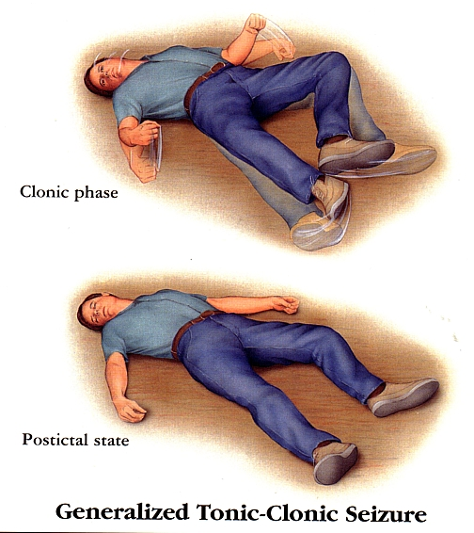
Generalized Seizure
May cry out or gasp, fall down, become rigid
Muscle may jerk, breathing becomes shallow
May lose bladder and bowel control
May drool, bite the tongue or lips and may turn blue
Post ictal -maybe confused, drowsy, sleep for a while or have headache

Slide 32
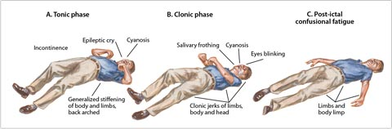
TONIC-CLONIC SEIZURES
Notes:
This is the type of seizure most people associate with epilepsy. A generalized tonic-clonic seizure often begins without warning. It involves a sudden stiffness of the body, followed by muscle contractions or jerking motions. There may also be changes in blood pressure, an increase in saliva, and loss of bladder control. This type of seizure has a high risk of injury due to the potential for falling to the ground and the sometimes violent jerking movements.

Slide 33
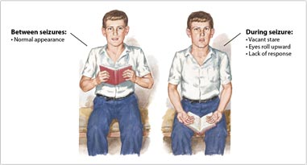
ABSENCE SEIZURES
Notes:
Absence seizures often occur in young children and are commonly mistaken for daydreaming. An absence seizure involves a brief disruption of consciousness—lasting from a few seconds to about half a minute. Typically, this seizure starts suddenly: the student stops what he or she is doing and stares blankly. This student’s eyes may roll upwards briefly before this event and then the episode disappears as quickly as it came. There is usually a loss of awareness for a few seconds. For example, you may call the student’s name, and he or she won’t respond. Absence seizures can happen many times a day.

Slide 34
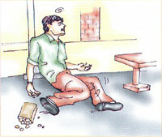
ATONIC SEIZURE
Notes:
Atonic seizures
Sometimes known as a "drop attack," atonic seizures cause a sudden loss of muscle tone. This may result in the dropping of the head or a limb, or lead a student to fall to the ground. There also may be a brief loss of consciousness. Because the student may fall to the ground, there is a risk of injury.

Slide 35
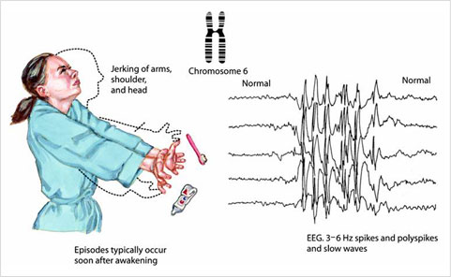
MYCLONIC SEIZURES
Notes:
Myoclonic seizures are one of the most common types of seizures, typically affecting children and young adults. A myoclonic seizure involves a sudden contraction of muscles and can appear as a jerk of one or both arms or sometimes the head. Myoclonic seizures may cause just a single jerk or several jerking movements. Generally, the seizure is so brief that although the student loses consciousness, he or she may appear conscious. While myoclonic seizures are common, you may be less likely to see them in the classroom as they often happen while falling asleep or within a short time of waking up.

Slide 36
Diagnosis of epilepsy in ASD is complicated because seizures may be mistaken for behaviors (not responding to name calling as in Absence).
Unusual repetitive behaviors, common in autism, hard to distinguish from seizures.
All seizure types may be seen.

Slide 37
Prevalence of epilepsy and types of seizures vary
Swedish study: complex partial, atypical absence, myoclonic and tonic-clonic most common
American study: tonic clonic and atypical absence most common
Other studies state complex partial with centro-temporal spikes most common

Slide 38
HOW TO MAKE A DIAGNOSIS
CLINICAL: Observe and document the event/s
Electroencephalogram (EEG): either routine or with Video EEG monitoring
Caveat: A Normal EEG does not rule out the diagnosis of Epilepsy. Likewise, an ABNORMAL EEG does not always mean that the person has EPILEPSY.

Slide 39
Value of EEG
Some studies suggest that epileptiform discharges on EEG without seizures can cause behavioral and cognitive impairment
Epilepsy more common in children who regressed in language after age 3.
Usually treat based on clinical seizures not just EEG findings.
Notes:
Usually treat based on clinical seizures not just EEG findings. Should anti-epileptic medication be prescribed to children with autism, language regression and EEG abnormalities?

Slide 40
Long-duration EEGs that include slow wave sleep more likely to show epileptiform abnormalities
Long-duration EEG of children with autism spectrum disorder and regression without clinical seizures – 46% with epileptiform activity
Focal spikes - Centrotemporal spikes and temporoparietal spikes
Notes:
Long EEG especially important in autistic children; AR form of epileptic encephalopathy; CNS guidelines – inadequate evidence to recommend EEG on all

Slide 41
Principles of Therapy in Epilepsy
The aim of therapy in epilepsy is seizure freedom without clinically significant adverse effects.
Correct seizure and often syndrome diagnosis is a precondition for the success of therapeutic decisions
Treatment regimens are usually with AEDs in continuous prophylactic schemes

Slide 42

Philip Bombastus Von Hohenheim
The right dose differentiates a poison and remedy.

Slide 43
Starting Treatment
Key Points in Treatment
To achieve seizure freedom without reaching any adverse events
The first option of AED is usually the most efficacious and the least likely to cause AE
The correct AED dose is the smallest one that achieves seizure control without AE
Titrating to the limit of tolerability may improve AED efficacy, but often at the cost of AE
Optimal efficacy of an AED may be lost by exceeding tolerability limits

Slide 44


Choosing the Right AED
Efficacy
Safety and Tolerability
Good seizure control
Adverse Drug Effects

Slide 45
Number of AEDs available
More
20
Levetiracetam
Oxcarbazepine
Tiagabine
15
Fosphenytoin
Topiramate
Gabapentin
Felbamate
Zonisamide
Lamotrigine
10
Sodium valproate
Vigabatrin
Carbamazepine
Ethosuximide
Benzodiazepines
5
Phenytoin
Phenobarbital
Primidone
Bromide
0
1840
1860
1880
1900
1920
1940
1960
1980
2000
Calendar year

Slide 46
NEUROIMAGING STUDIES:
When are they needed and what to request?

Slide 47
MRI or CT scan: with contrast or plain study
The decision should be individualized and will be dependent on the clinical findings and suspected etiology of the seizures.

Slide 48
Treatment of epilepsy in persons with autism
Should anti-epileptic medication be prescribed to children with autism, language regression and subclinical EEG abnormalities?

Slide 49
Medical treatment of seizures in autism similar to treating other children with epilepsy
  Data is limited on response of children with epileptiform EEG without clinical seizures
Reports exist that language in children with autism improved in response to anticonvulsants.
Notes:
Premise that epileptiform activity causes verbal agnosia; especially depakote, zarontin and benzo

Slide 50
Improvements have also been reported in patients treated with corticotropin, steroids, or immunoglobulins.
Clinical reports of the use of Depakote in children with autism with and without clinical seizures
  Reports of improvement in core symptoms of epilepsy
Surgical resection in children with autism and intractable epilepsy – may improve seizures +/- autistic symptoms.

Slide 51
Because of absence of clinical trials, no definitive recommendations or guidelines for epilepsy treatment in persons with Autism exist.
Medical treatment of seizures in autism similar to treating other persons with epilepsy.
Notes:
Surgery not recommended for those without clinical seizures;

Slide 52
Acknowledgement
Some slides were obtained from the ILAE website,
Report of the Commission on Classification and Terminology
http://www.ilae.org/Visitors/Centre/ctf/ctfoverview.cfm

