Slide 1

Nutrition-related comorbidity in ASD and their nutritional management
Cecile Leah T. Bayaga, RND
Department of Food Science and Nutrition College of Home Economics
University of the Philippines-Diliman
2014 AAAP Symposium
13 September 2014
Makati City

Slide 2
What is comorbidity?
Defined as the co-occurrence of two or more disorders in the same person (Matson & Nebel-Schwaim, 2007).
A comorbid condition is a second order diagnosis which offers core symptoms that differ from the first disorder (Mannion & Leader, 2013).

Slide 3
What are the common comorbidity in ASD?
Attention deficit/hyperactivity disorder (AD/HD)
Epilepsy
Gastrointestinal symptoms
Sleep problems
Feeding problems
Toileting problems
Nutrition-related
Mannion & Leader, 2013

Slide 4
Why is nutrition important in autism awareness?
What a child eats is very powerful. It can make the body strong, weak, healthy, or sickly.
When a child's body is healthier and functioning better, mood and learning improve, and subsequently children can get even more benefit from their therapies such as ABA, speech, OT/PT and others.

Slide 5
Objective
To discuss the comorbid conditions in autism spectrum disorder related to nutrition
- Gastrointestinal problems; and
- Feeding problems which may lead to body weight concerns.
Evidence-based

Slide 6
Gastrointestinal symptoms

Slide 7
Molloy & Manning-Courtney (2003)
Investigated the prevalence of GI symptoms in children with ASD
Participants’ age: 24 -96 months (N=137)
Medical records
24% of the participants had a history of at least one GI symptom. No association was found between GI symptoms and developmental regression.

Slide 8
Hansen et al. (2008)
Examined the prevalence of regressive autism and associated demographic, medical and developmental factors
Participants’ age: 2 – 5 years (N=333)
CHARGE gastrointestinal history form and CHARGE sleep history form
No statistically significant differences were found between children with/without regressive autism in term of GI symptoms & sleep problems

Slide 9
Valicenti-McDermott et al. (2008)
Investigated GI symptoms & language regression
Participants’ age: 1 – 18 years (N=100)
Gastrointestinal interview
Children with language regression had more GI problems than those without language regression.

Slide 10
Ibrahim et al. (2009)
Compared children with ASD and GI symptoms to matched control participants
Participants’ age: up to 18 years
N = 363 ( 121 case participants and 2 controls per case participants)
Medical records
No significant association found between ASD and GI symptoms except more children with ASD had constipation and feeding issues.

Slide 11
Nikolov et al. (2009)
Evaluated GI symptoms in children with pervasive developmental disorders
Participants’ age: 5 – 17 years (N=172)
Medical history
Those with GI symptoms were no different from those without GI symptoms in terms of adaptive functioning or autism symptom severity.
Those with GI symptoms showed greater irritability, anxiety and social withdrawal.

Slide 12
Wang et al. (2011)
Compared children with ASD to their siblings in relation to GI symptoms
Participants’ age: 1 – 18 years
N = 752 (589 participants with ASD and 163 of their siblings in the control group)
Structured medical history interview
More GI symptoms in children with ASD than their typically developing siblings.
Increased autism symptom severity was associated with higher odds of GI problem.

Slide 13
Gorrindo et al. (2012)
Compared 3 groups: ASD + GI symptoms; ASD + no GI symptoms; and, GI symptoms only
Participants’ age: 5 – 17 years (N=121)
Clinical evaluation by pediatric gastroenterologists
Constipation was the most common GI problem in ASD.
Constipation was associated with younger age, increased social impairment and lack of expressive language.

Slide 14
Masurek et al. (2013)
Investigating the relationship between GI symptoms, anxiety and sensory over-reponsivity
Participants’ age: 2 – 17 years (N=2973)
GI symptom inventory questionnaire (Autism Treatment Network, 2005)
Children with each type of GI symptom had significantly higher rates of anxiety and sensory over-responsivity.

Slide 15
What were the most common GI symptoms reported?
Chronic constipation
Diarrhea
Abdominal pain
GI inflammation – reflux, bloody stools, vomiting, and gaseousness
The reported prevalence of GI abnormalities in individuals with ASD ranges from 9% to 91% across different studies (Hsiao, 2014).
Hsiao EY, 2014

Slide 16
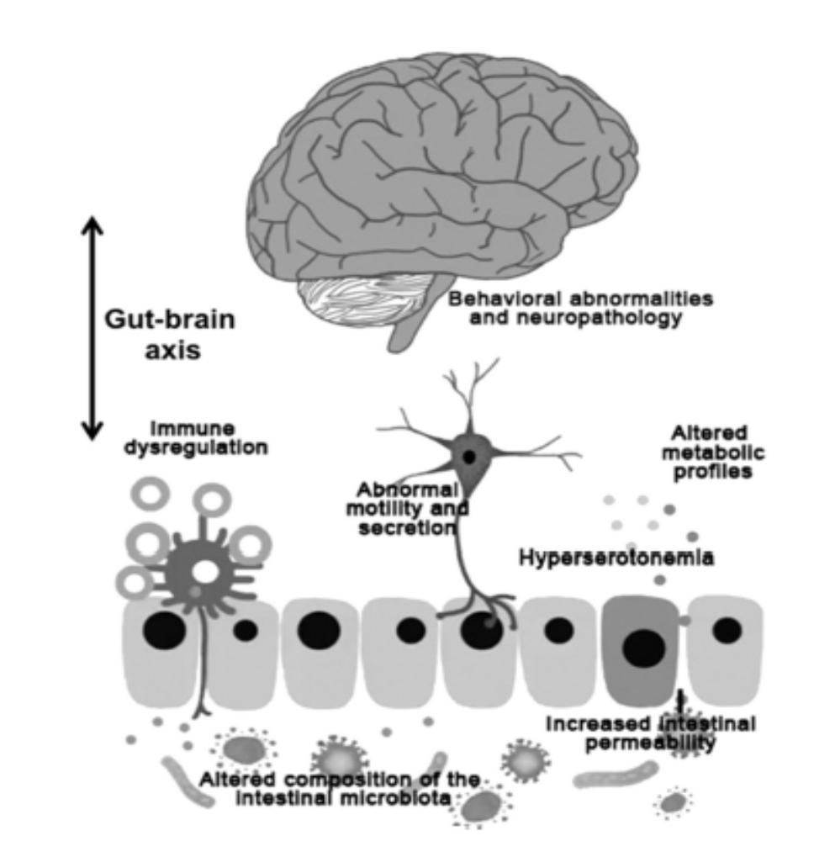
Gastrointestinal influences on symptoms of ASD
Hsiao EY, 2014

Slide 17
GI issues that result in distress or discomfort can potentiate problem behaviors such as abnormal mouthing, self injury to the abdomen, vocal groaning, or screaming
Casein- and gluten-free diet (CFGF)
The utility of CFGF diet to treat co symptoms of autism is largely derived from anecdotal accounts and lacks empirical support from well-designed scientific studies (Hsiao, 2014)

Slide 18
Managing constipation

Slide 19
What is constipation?
Hard stools
Pain or trouble passing stool
Less than three stools per week

Slide 20
How to manage constipation?
Diet changes
- Increase fiber intake
- Increase fluid intake
2. Behavior changes
- Regular exercise
3. Use of prescribed medicines

Slide 21
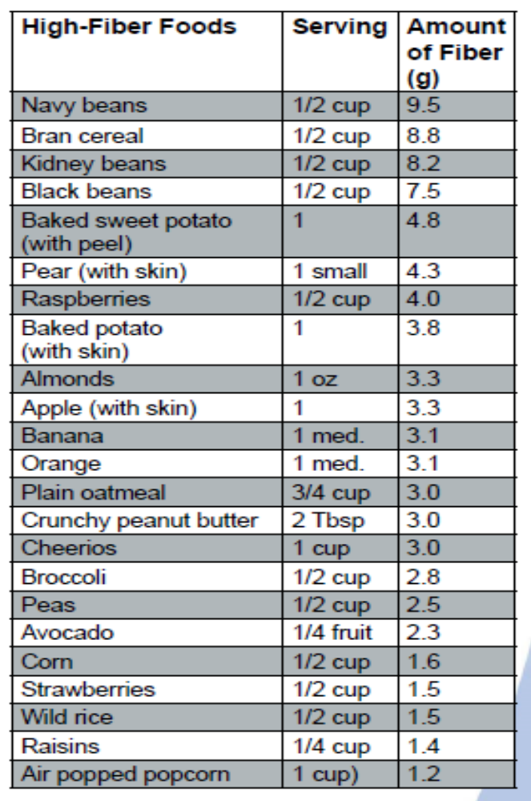


Slide 22
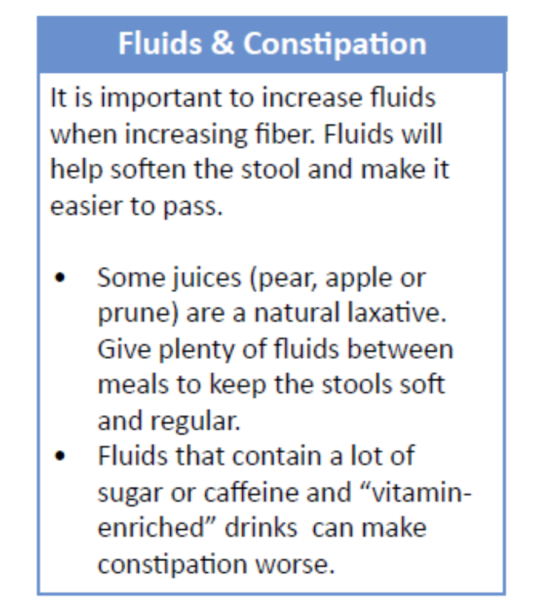
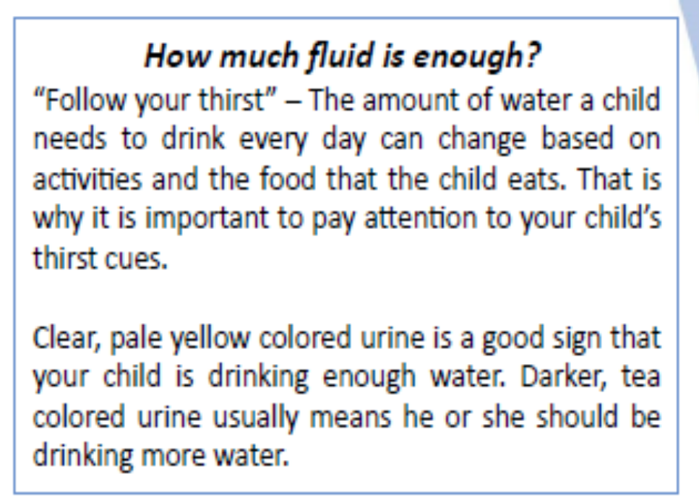
Autism Speaks Autism Treatment Network Parents’ Tool Kit

Slide 23
Feeding problems

Slide 24
Why the concern over feeding problems?
Children diagnosed with autism and PDD would often be fussy eaters.
Fussy eaters dislike certain food textures, which may lead to a limited array of accepted food for consumption.
It’s a behavior that leads to undernutrition, growth failure, overweight, micronutrient deficiencies, and osteopenia especially for children with neurologically disabilities (Marchand, V. et al., 2006).

Slide 25
Schreck, Williams et al. (2004)
To compare eating behavior in children with and without autism
Participants’ age: 7 – 9.5 years (N=436)
Children’s Eating Behavior Inventory (Archer et al., 1991)
Children with autism have significantly more feeding problems and eat a narrower range of foods than children without autism.

Slide 26
Fodstad and Matson (2008)
To compare feeding & mealtime problems in adults with intellectual disabilities (ID) with and without autism
Participants’ age: 18 – 69 years (N=60)
Screening tool of feeding problems (Matson & Khun, 2001)
Those with ASD + ID displayed more behaviorally-based feeding problems, such as food selectivity and refusal related difficulties compared to those with ID alone.

Slide 27
Bardini et al. (2010)
To compare food selectivity in children with ASD and typically developing children
Participants’ age: 3 – 11 years (N=111)
Modified version of Youth/Adolescent FFQ (Field et al., 1999)
Children with ASD exhibited more food refusal and had a more limited food repertoire than typically developing children.

Slide 28
Sharp et al. (2013)
To assess feeding problem using multi-method assessment
Participants’ age: 3 – 8 years (N=30)
Food Preference Inventory Brief Autism Mealtime Behavior Inventory (BAMBI) (Lukens & Linscheid, 2008) and standardized mealtime observation
Increased food selectivity was positively correlated with problem behaviors during observation.

Slide 29
Feeding problems
???
Weight problems

Slide 30
Broder-Fingert et al. (2014)
To compare the prevalence of overweight and obesity in children with ASD to those without ASD, who acted as control subjects.
Participants’ age: 2 – 20 years (N=6672)
Calculated age-adjusted, sex-adjusted body mass index and classified children as overweight (body mass index 85th to 95th percentile) or obese (> 95th percentile).
Compared to control subjects, children with autism and Asperger syndrome had significantly higher odds of overweight and obesity.

Slide 31
Curtin et al. (2014)
To summarize the literature on the prevalence of, and risk factors for, obesity in ASD.
A literature search was undertaken using electronic databases of PubMed, Google Scholar, Ovid, and MEDLINE to locate relevant literature published in English in the last 25 years.
The prevalence of obesity in children with ASD is at least as high as that seen in typically developing children. Many of the risk factors for children with ASD are likely the same as for typically developing children.

Slide 32
Children wit ASD may be more vulnerable to additional risk factors not shared by children in the general population, including psychopharmacological treatment, genetics, disordered sleep, atypical eating patterns, and challenges for engaging in sufficient physical activity.

Slide 33
Managing feeding problems

Slide 34
What can be done at home to help with feeding issues?
Set a feeding schedule and routine
Avoid all day eating
Provide comfortable and supportive seating
Limit mealtime
Minimize distractions
Get your child involved
Practice pleasant and healthy eating behaviors

Slide 35
What can be done at home to help with feeding issues?
8. Reward positive behaviors
9. Ignore negative behaviors
10. Remember the Rule of 3
11. Aesthetic presentation

Slide 36
Feeding can be very stressful for the child and for the family.
Helping your child overcome feeding issues can be a long, slow journey, but it is well worth the reward of better health and food flexibility.

Slide 37
Nutrition-related comorbidity in ASD and their nutritional management
Cecile Leah T. Bayaga, RND
cecile.bayaga@gmail.com
2014 AAAP Symposium
13 September 2014
Makati City

